Slide 1
me
STUDENT DETAILS

Slide 2
Mental fitness tracker

Slide 3
PROBLEM STATEMENT
The problem addressed by the Mental Fitness Tracker project is the need to understand and improve mental well-being. Mental health is a complex and multifaceted aspect of overall well-being, influenced by various factors. However, gaining insights into the relationships between these factors and mental fitness, and developing effective interventions, can be challenging. The project aims to tackle this problem by analyzing mental fitness data, exploring the factors that impact mental well-being, and developing predictive models to enhance understanding and facilitate interventions for mental health improvement.

Slide 4
AGENDA
1. Data Preparation
2. Exploratory Data Analysis (EDA)
3. Model Training and Evaluation
4. Summary and Conclusion
The project aims to analyze mental fitness data and provides insights, accurate predictions.
We aim to Impact global mental well-being.

Slide 5
PROJECT OVERVIEW
The Mental Fitness Tracker project aims to analyze mental fitness data and develop predictive models to understand and improve mental well-being. The project involves collecting data from multiple CSV files, focusing on mental health and factors that influence mental fitness.
After preprocessing the data by handling missing values and converting data types, exploratory data analysis is conducted using various visualizations. Regression models, including Linear Regression, Random Forest, Gradient Boosting Regression, and Lasso Regression, are trained and evaluated using metrics such as MSE, RMSE, and R2. The best performing model is identified, and scatter plots of actual versus predicted values are visualized.
The project provides valuable insights into mental fitness and has the potential to contribute to the enhancement of mental well-being.

Slide 6
WHO ARE THE END USERS of this project?
The potential end users of this project can vary depending on the application of the project Here are a few examples of who might benefit from or use the project's outcomes:
1. Mental Health Professionals: Mental health professionals, including psychologists, therapists, counselors, and psychiatrists, can leverage the project's insights and predictive models to better understand the factors influencing mental fitness.
2. Public Health Organizations: Public health organizations and agencies concerned with mental health can utilize the project's findings to gain insights into population-level mental fitness trends.

Slide 7
3. Researchers and Academics: Researchers and academics in the field of mental health and psychology can benefit from the project's analysis and methodologies. They can use the findings as a basis for further research, exploration of causal relationships, and development of more advanced models for predicting mental fitness
4. Technology Developers: Developers and companies working on mental health-related applications, digital platforms, or wearable devices can integrate the project's predictive models and insights into their products. This can enhance the accuracy and effectiveness of mental fitness tracking tools, providing users with personalized recommendations and interventions for maintaining or improving their mental well-being.
5. Individuals and General Public: The project's outcomes can also be valuable for individuals seeking to understand and monitor their own mental fitness. The predictive models and insights can help individuals gain insights into their mental well-being, identify potential risk factors, and make informed decisions about self-care and seeking professional help when needed.

Slide 8
YOUR SOLUTION AND ITS VALUE PROPOSITION
Solution:
The Mental Fitness Tracker is a data-driven project that analyzes mental fitness data and develops predictive models to understand and improve mental well-being. By leveraging machine learning techniques and comparing different Regression models to explore relationships between various factors and mental fitness, the project provides valuable insights into the complexities of mental health.
Valuable Propositions:
Enhanced understanding of the factors influencing mental fitness by analyzing diverse datasets
The project offers personalized insights into an individual's mental fitness.
The project's outcomes can be integrated into technology solutions, such as mental health applications and wearable devices.
With its focus on global mental well-being, the project aims to have a positive impact on mental health at a larger scale
Mental health professionals and public health organizations can use the insights to design effective interventions and health policies

Slide 9
How did you customize the project and make it your own
I have customized the project by the following steps:
Simplifying the code base and enhancing code readability
Adding more regression models to compare performance
Including comments throughout your code to explain the purpose and functionality of specific sections
Refining Exploratory Data Analysis steps
Defining the performance metrics that are most relevant to evaluating the models' success in achieving the specific goal
Customizing the Result Interpretation by sorting models based on performance and categorizing the best and worst performing models
summarizing the results to give insights on the final project

Slide 10
MODELLING
The project uses Python as the programming language and various libraries for data manipulation, visualization and machine learning.
Uses pandas, numpy, matplotlib, seaborn, scikit-learn and portly libraries for data manipulation, visualization and machine learning.
Uses Linear Regression, Random Forest Regressor, Gradient Boosting Regressor and Lasso classes from sklearn to create different regression models to predict the mental fitness of a country based on various factors.
The project was done in Google Collab notebook, which is a cloud-based platform that allows you to write and execute Python code online

Slide 11
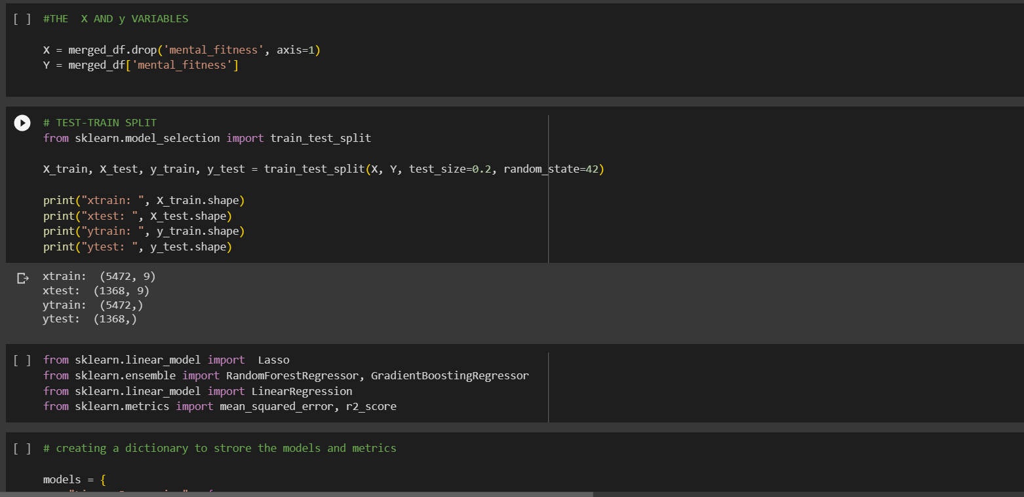
Data splitting and importing models

Slide 12
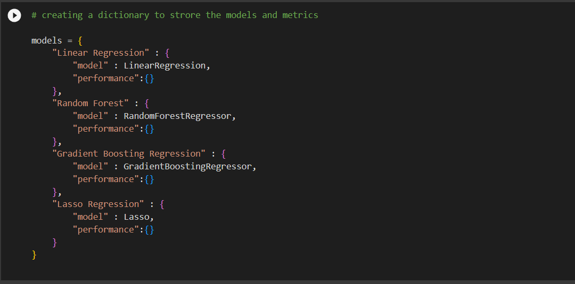
A dictionary to store the progress of each models

Slide 13
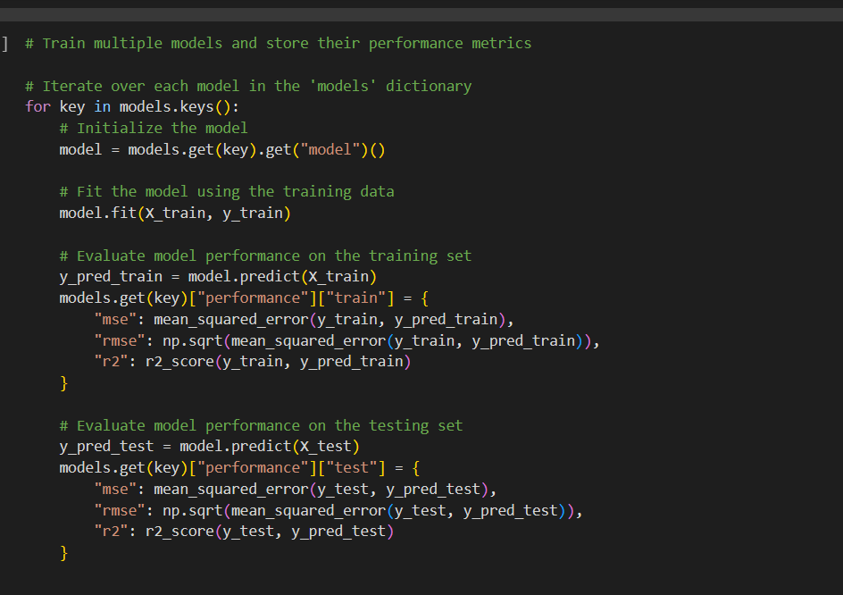
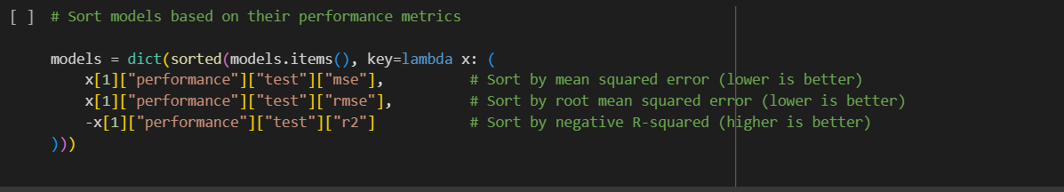
Training and sorting models based on performance

Slide 14
Results
The project found that the mental fitness of a country is influenced by various factors such as schizophrenia, bipolar disorder, eating disorder, anxiety, drug usage, depression and alcohol consumption.
The project created and evaluated four regression models to predict the mental fitness of a country based on the factors mentioned above. The best performing model was the Random Forest model, which achieved a comparatively low mean squared error and a high coefficient of determination on the test set.
The Mental Fitness Tracker project offers a comprehensive approach to understanding mental health by analyzing and predicting mental fitness levels.

Slide 15
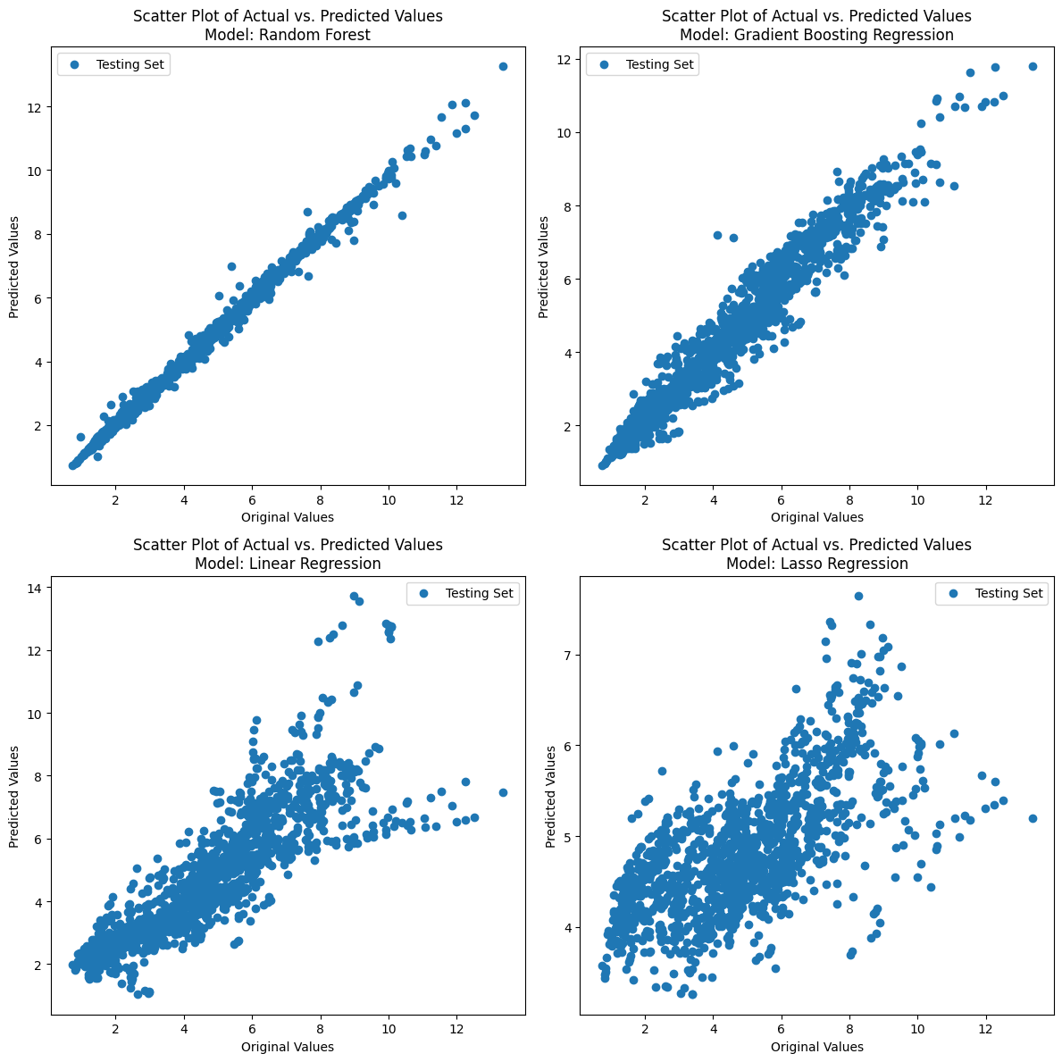
Model performance comparison

Slide 16
links
The dataset used in this project includes two CSV files available from Kaggle Mental Health Dataset | Kaggle
mental-and-substance-use-as-share-of-disease.csv
prevalence-by-mental-and-substance-use-disorder.csv

